Slide 1
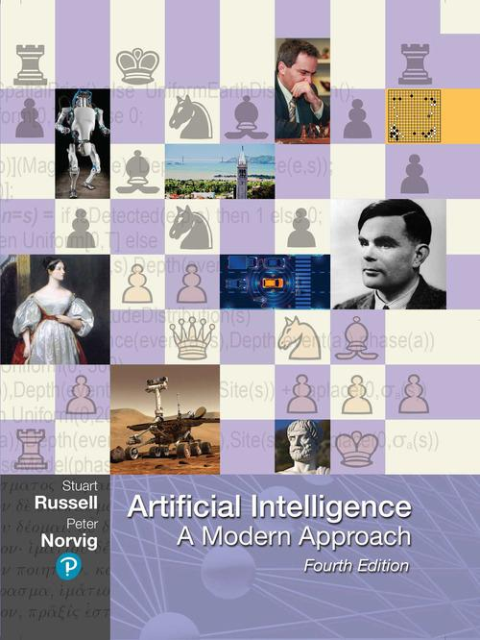
Artificial Intelligence: A Modern Approach
Fourth Edition
Lecture 1
Intelligent Agents
Copyright © 2021 Pearson Education, Inc. All Rights Reserved
Notes:
If this PowerPoint presentation contains mathematical equations, you may need to check that your computer has the following installed:
1) MathType Plugin
2) Math Player (free versions available)
3) NVDA Reader (free versions available)

Slide 2
Outline
Agents and environments
Rationality
PEAS (Performance measure, Environment, Actuators, Sensors)
Environment types
Agent types

Slide 3
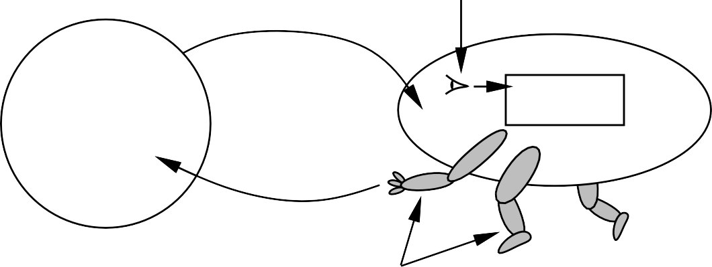
Agents and environments
sensors
percepts
?
agent
environment
actions
actuators
Agents include humans, robots, softbots, thermostats, etc.
An agent can be anything that can be viewed as perceiving its environment through sensors and acting upon that environment through actuators
The agent function maps from percept histories to actions:
f : P∗ → A
The agent program runs on the physical architecture to produce f

Slide 4







Vacuum-cleaner world
A B
Percepts: location and contents, e.g., [A, Dirty]
Actions: Left, Right, Suck, N oOp

Slide 5
A vacuum-cleaner agent
Percept sequence | Action
[A, Clean] | Right
[A, Dirty] | Suck
[B, Clean] | Left
[B, Dirty] | Suck
[A, Clean], [A, Clean] | Right
[A, Clean], [A, Dirty] | Suck
. | .
function Reflex-Vacuum-Agent( [location,status]) returns an action
if status = Dirty then return Suck else if location = A then return Right else if location = B then return Left
What is the right way to fill out this table?
What makes the agent good or bad?
What is the right function?
Can it be implemented in a small agent program?

Slide 6
Rationality
What is rational at any given time depends on four things:
The performance measure that defines the criterion of success.
The agent’s prior knowledge of the environment.
The actions that the agent can perform.
The agent’s percept sequence to date.
This leads to a definition of a rational agent:
For each possible percept sequence, a rational agent should select an action that is expected to maximize its performance measure, given the evidence provided by the percept sequence and whatever built-in knowledge the agent has.

Slide 7
Rationality
What is rational at any given time depends on four things:
The performance measure that defines the criterion of success.
The performance measure awards one point for each clean square at each time step, over a “lifetime” of 1000 time steps.
The agent’s prior knowledge of the environment.
The “geography” of the environment is known a priori but the dirt distribution and the initial location of the agent are not. Clean squares stay clean and sucking cleans the current square. The and actions move the agent one square except when this would take the agent outside the environment, in which case the agent remains where it is.
The actions that the agent can perform.
The only available actions are Right, Left and Suck.
The agent’s percept sequence to date.
The agent correctly perceives its location and whether that location contains dirt.
This leads to a definition of a rational vacuum-cleaner agent: Under these circumstances the agent is indeed rational; its expected performance is at least as good as any other agent’s.

Slide 8
Rationality
Fixed performance measure evaluates the environment states sequence
one point per square cleaned up in time T ?
one point per clean square per time step, minus one per move?
penalize for > k dirty squares?
A rational agent chooses whichever action maximizes the expected value of the performance measure given the percept sequence to date
Rational ≠ omniscient (note example pg.59)
percepts may not supply all relevant information Rational ≠ clairvoyant
action outcomes may not be as expected Hence, rational ≠ successful
Rational ⇒exploration, learning, autonomy

Slide 9
PEAS
The characteristics of the performance measure, environment, action space and percepts dictate approaches for selecting rational actions. They are summarized as the task environment.
Consider, e.g., the task of designing a self-driving car: Performance measure??
Environment?? Actuators??
Sensors??

Slide 10
PEAS
To design a rational agent, we must specify the task environment
Consider, e.g., the task of designing a self-driving car:
Performance measure?? safety, destination, profits, legality, comfort, . . .
Environment?? US streets/freeways, traffic, pedestrians, weather, . . .
Actuators?? steering, accelerator, brake, horn, speaker/display, . . .
Sensors?? video, accelerometers, gauges, engine sensors, keyboard, GPS,speedometer . . .

Slide 11
Internet shopping agent
Performance measure??
Environment??
Actuators??
Sensors??

Slide 12
Internet shopping agent
Performance measure?? price, quality, appropriateness, efficiency
Environment?? current and future WWW sites, vendors, shippers Actuators?? display to user, follow URL, fill in form
Sensors?? HTML pages (text, graphics, scripts)

Slide 13
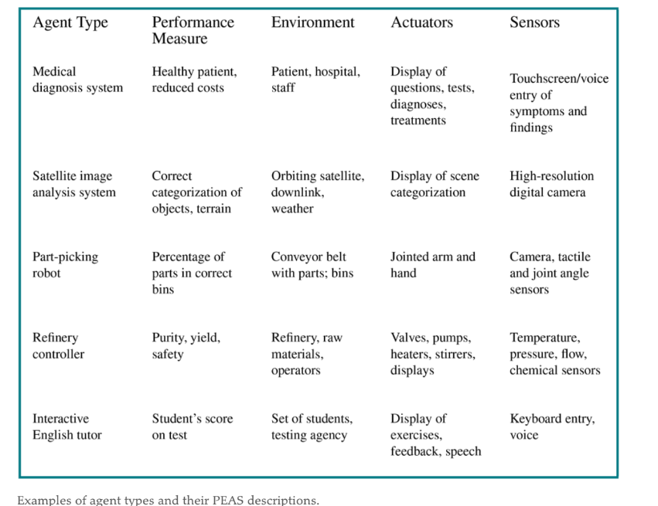

Slide 14
Environment types
Fully observable vs. partially observable
Whether the agent sensors give access to the complete state of the environment, at each point in time.
Deterministic vs. stochastic
Whether the next state of the environment is completely determined by the current state and the action executed by the agent.
Episodic vs. sequential
Whether the agent's experience is divided into atomic independent episodes.
Static vs. dynamic
Whether the environment can change, or the performance measure can change with time.

Slide 15
Cont…
Discrete vs. continuous
Whether the state of the environment, the time, the percepts or the actions are continuous.
Single agent vs. multi-agent
Whether the environment include several agents that may interact which each other.
Known vs. unknown
Reflects the agent's state of knowledge of the "law of physics" of the environment.

Slide 16
Environment types Examples
 | Solitaire Backgammon Internet shopping Taxi
Observable?? Deterministic?? Episodic?? Static?? Discrete?? Single-agent?? | Yes Yes No No

Slide 17
Environment types
 | Solitaire Backgammon Internet shopping Taxi
Observable?? Deterministic?? Episodic?? Static?? Discrete?? Single-agent?? | Yes Yes No No Yes No Partly No

Slide 18
Environment types
 | Solitaire Backgammon Internet shopping Taxi
Observable?? Deterministic?? Episodic?? Static?? Discrete?? Single-agent?? | Yes Yes No No Yes No Partly No No No No No

Slide 19
Environment types
 | Solitaire Backgammon Internet shopping Taxi
Observable?? Deterministic?? Episodic?? Static?? Discrete?? Single-agent?? | Yes Yes No No Yes No Partly No No No No No Yes Semi Semi No

Slide 20
Environment types
 | Solitaire Backgammon Internet shopping Taxi
Observable?? Deterministic?? Episodic?? Static?? Discrete?? Single-agent?? | Yes Yes No No Yes No Partly No No No No No Yes Semi Semi No Yes Yes Yes No

Slide 21
Environment types
 | Solitaire Backgammon Internet shopping Taxi
Observable?? Deterministic?? Episodic?? Static?? Discrete?? Single-agent?? | Yes Yes No No Yes No Partly No No No No No Yes Semi Semi No Yes Yes Yes No Yes No Yes (except auctions) No
The environment type largely determines the agent design
The real world is (of course) partially observable, stochastic, sequential, dynamic, continuous, multi-agent

Slide 22
Agent programs
Our goal is to design an agent program that implements the agent function.
Agent programs can be designed and implemented in many ways:
with tables
with rules
with search algorithms
with learning algorithms

Slide 23
Agent types
Four basic types in order of increasing generality:
simple reflex agents
model-based reflex agents
goal-based agents
utility-based agents
All these can be turned into learning agents

Slide 24
Simple reflex agents select actions on the basis of the current percept, may have memory or model of the world's current state, ignoring the rest of the percept history.
They implement condition-action rules that match the current percept to an action.
Rules provide a way to compress the function table.
Example (autonomous car): If a car in front of you slow down, you should break. The color and model of the car, the music on the radio or the weather are all irrelevant.
They can only work in a Markovian environment, that is if the correct decision can be made on the basis of only the current percept. In other words, if the environment is fully observable.

Slide 25
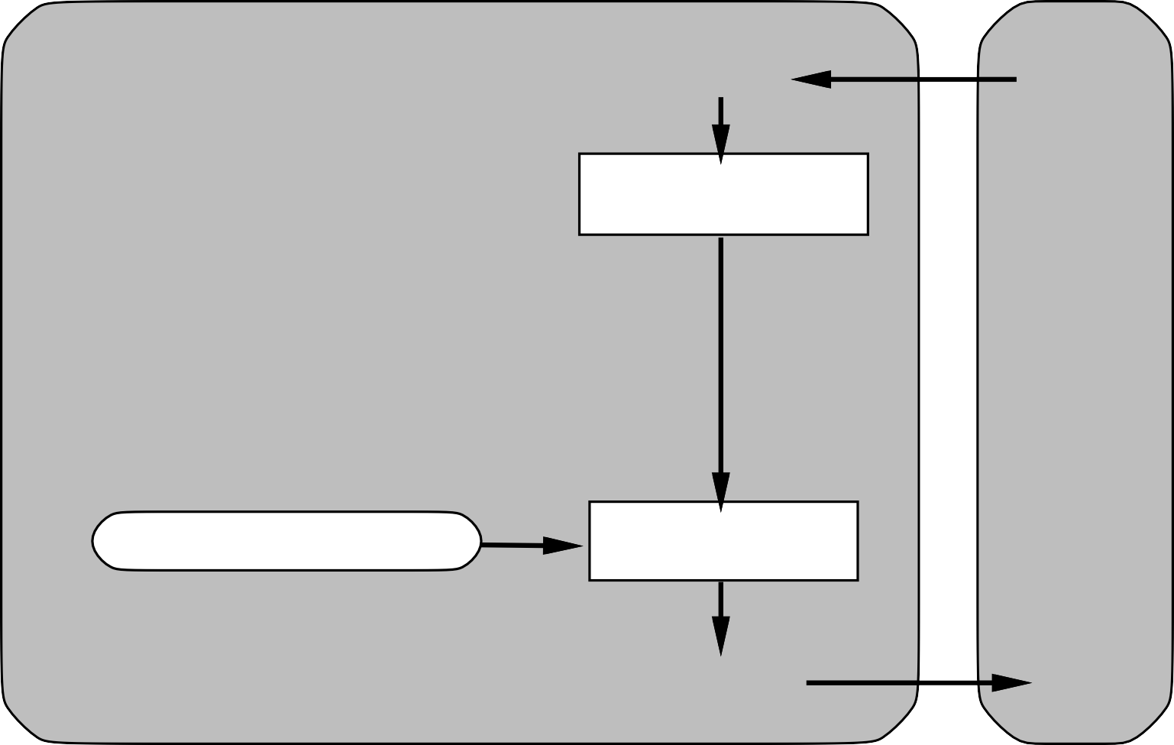
Simple reflex agents
Agent
Sensors
What the world is like now
Environment
Condition−action rules
What action I should do now
Actuators

Slide 26
Example
function Reflex-Vacuum-Agent( [location,status]) returns an action
if status = Dirty then return Suck else if location = A then return Right else if location = B then return Left
(setq joe (make-agent :name ’joe :body (make-agent-body)
:program (make-reflex-vacuum-agent-program))
(defun make-reflex-vacuum-agent-program () #’(lambda (percept)
(let ((location (first percept)) (status (second percept))) (cond ((eq status ’dirty) ’Suck)
((eq location ’A) ’Right) ((eq location ’B) ’Left)))))

Slide 27
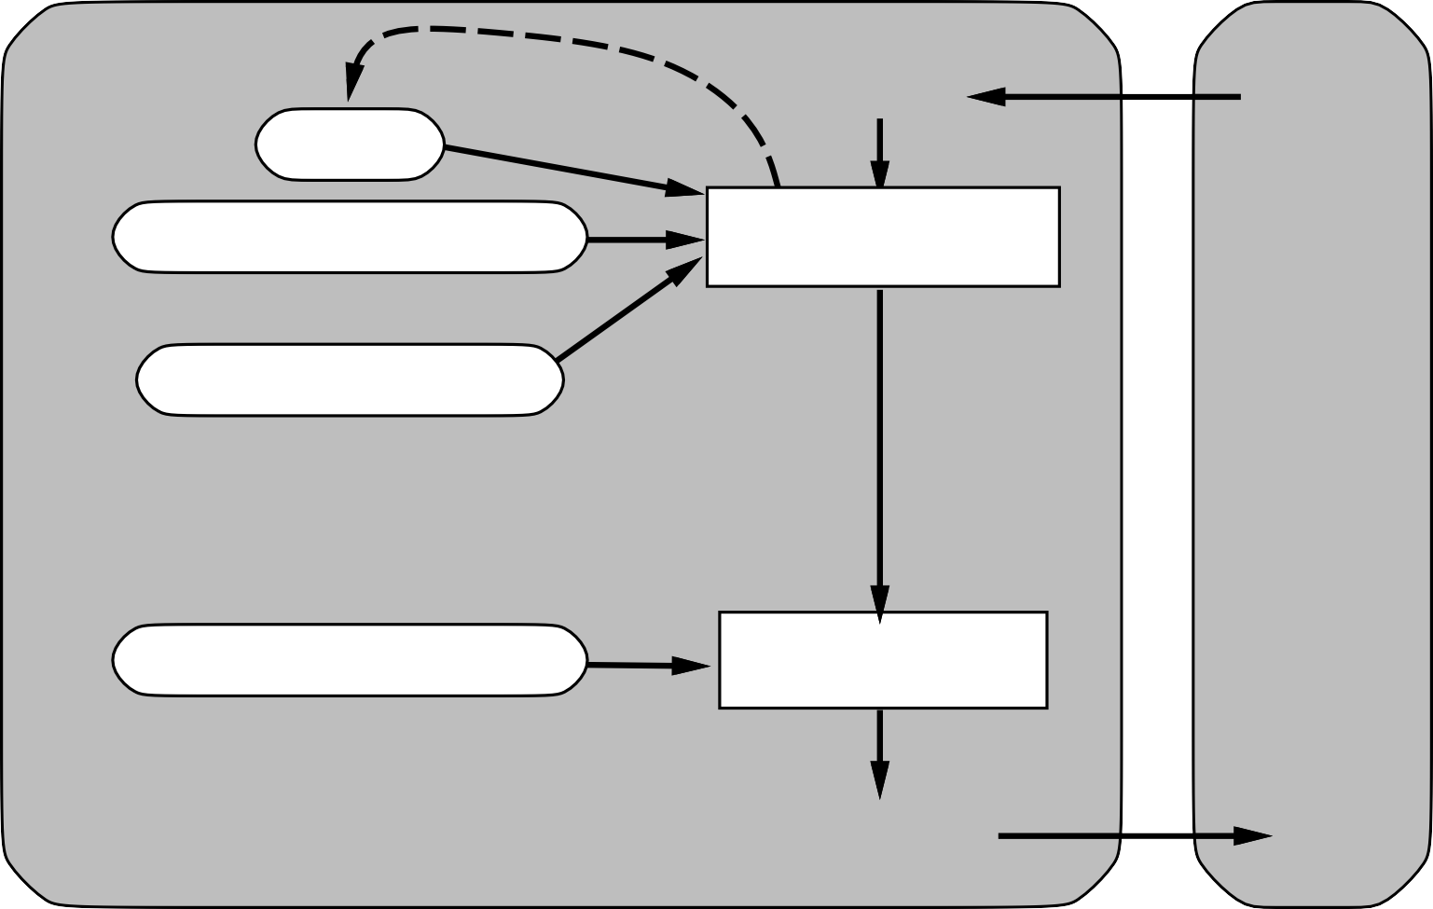
Reflex agents with state
Sensors
State
How the world evolves
What the world is like now
Environment
What my actions do
Condition−action rules
What action I should do now
Agent
Actuators

Slide 28
Example
function Reflex-Vacuum-Agent( [location,status]) returns an action
static: last A, last B, numbers, initially ∞
if status = Dirty then . . .
(defun make-reflex-vacuum-agent-with-state-program () (let ((last-A infinity) (last-B infinity)) #’(lambda (percept)
(let ((location (first percept)) (status (second percept))) (incf last-A) (incf last-B)
(cond
((eq status ’dirty)
(if (eq location ’A) (setq last-A 0) (setq last-B 0)) ’Suck)
((eq location ’A) | (if | (> last-B 3) | ’Right ’NoOp))
((eq location ’B) | (if | (> last-A 3) | ’Left ’NoOp)))))))

Slide 29

Model-based agents
Sensors
State
How the world evolves
What the world is like now
Environment
What my actions do
Goals
What action I should do now
Agent
Actuators

Slide 30
Model-based agents handle partial observability of the environment by keeping track of the part of the world they cannot see now.
The internal state of model-based agents is updated on the basis of a model which determines:
how the environment evolves independently of the agent;
how the agent actions affect the world.

Slide 31
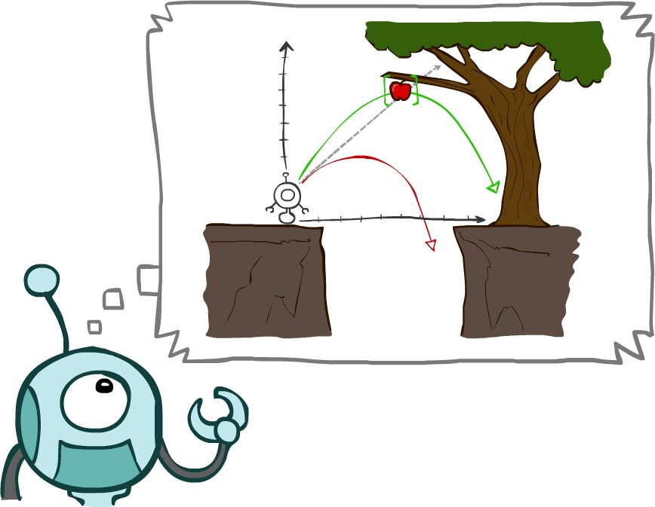
Planning agents
Planning agents:
ask "what if?";
make decisions based on (hypothesized) consequences of actions;
must have a model of how the world evolves in response to actions;
must formulate a goal.
Courtesy of UC Berkley

Slide 32
Goal-based agents
Sensors
State
How the world evolves
What the world is like now
Environment
What my actions do
What it will be like if I do action A
Goals
What action I should do now
Agent
Actuators

Slide 33
Decision process:
generate possible sequences of actions
predict the resulting states
assess goals in each.
A goal-based agent chooses an action that will achieve the goal.
More general than rules. Goals are rarely explicit in condition-action rules.
Finding action sequences that achieve goals is difficult. Search and planning are two strategies.

Slide 34

Utility-based agents
Sensors
State
How the world evolves
What the world is like now
Environment
What my actions do
What it will be like if I do action A
Utility
How happy I will be in such a state
What action I should do now
Agent
Actuators

Slide 35
Goals are often not enough to generate high-quality behavior.
Example (autonomous car): There are many ways to arrive to destination, but some are quicker or more reliable.
Goals only provide binary assessment of performance.
A utility function scores any given sequence of environment states.
The utility function is an internalization of the performance measure.
A rational utility-based agent chooses an action that maximizes the expected utility of its outcomes.

Slide 36
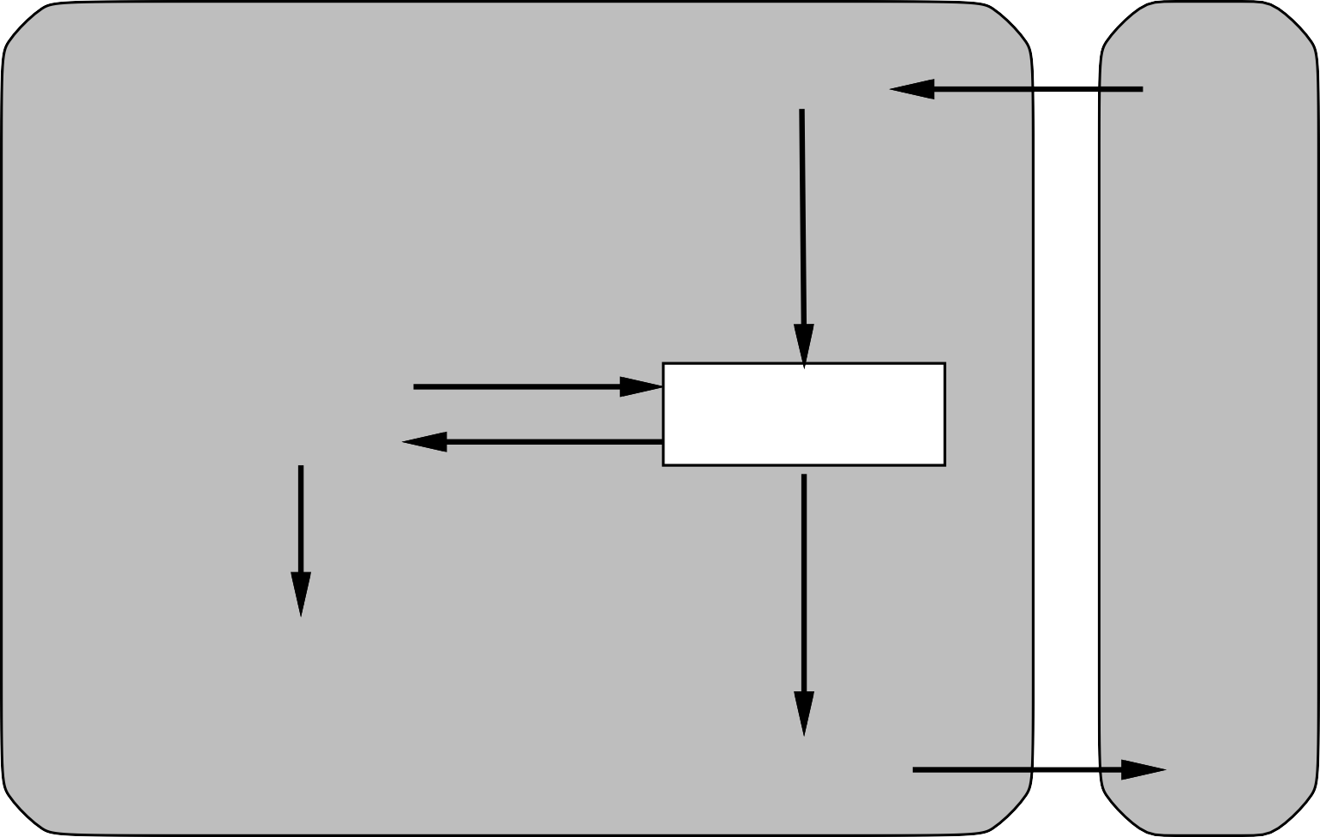
Learning agents
Performance standard
Critic
Sensors
feedback
changes
Environment
Learning element
Performance element
knowledge
learning goals
Problem generator
Agent
Actuators

Slide 37
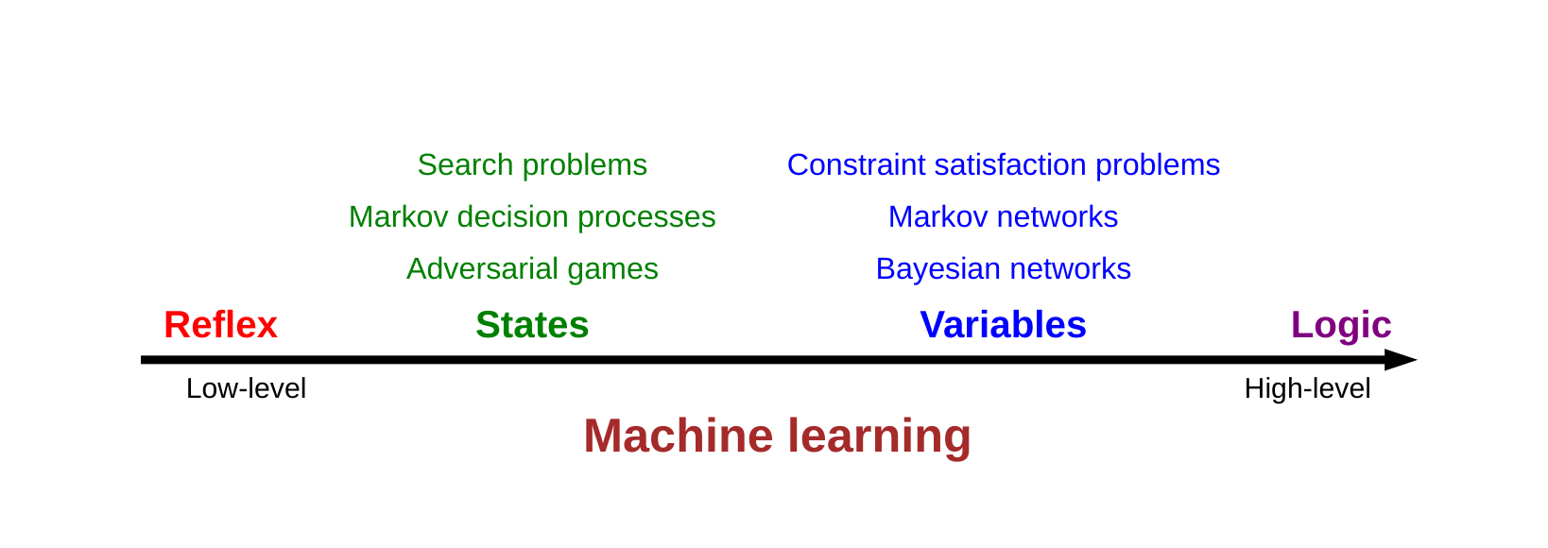
Learning agents are capable of self-improvement. They can become more
competent than their initial knowledge alone might allow.
They can make changes to any of the knowledge components by:
learning how the world evolves;
learning what are the consequences of actions;
learning the utility of actions through rewards.

Slide 38
Summary
Agents interact with environments through actuators and sensors
The agent function describes what the agent does in all circumstances The performance measure evaluates the environment sequence
A perfectly rational agent maximizes expected performance Agent programs implement (some) agent functions
PEAS descriptions define task environments Environments are categorized along several dimensions:
observable? deterministic? episodic? static? discrete? single-agent?
Several basic agent architectures exist:
reflex, reflex with state, goal-based, utility-based

